Slide 1

Treasure of Subway Data
Treasure of Subway Data
Amjad Alobaily
9 Sep 2021

Slide 2
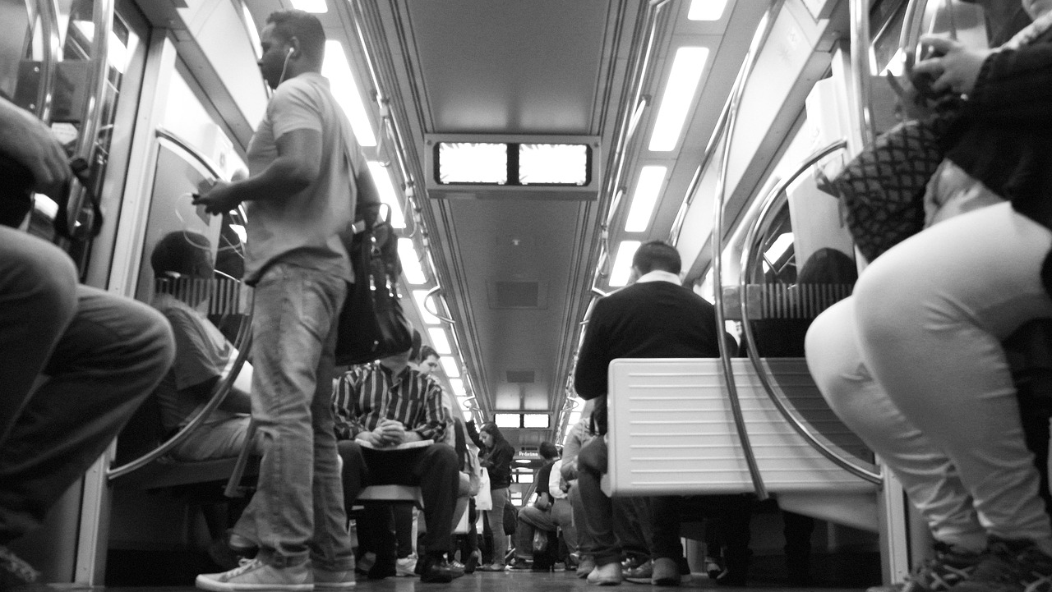
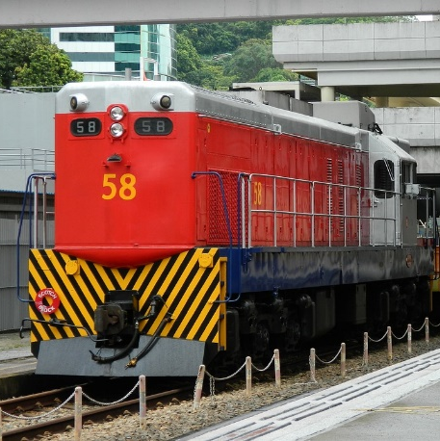
The Main Goals
You have a treasure, and this treasure undiscovered yet. It’s the data of the subway, during this presentation
I will show you how can you improve your investment and increase your seal and in sequences increase your profit

Slide 3

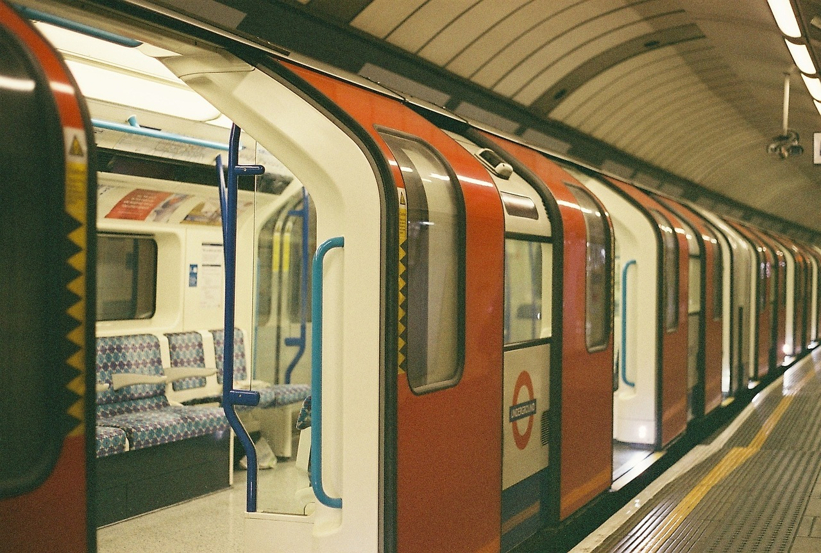
The data that I used for one year starting from 5th of September 2020 until 5th of September 2021 and the total record is :
11,111,813
Records
The Source of data.
All this data from web site : http://web.mta.info/developers/turnstile.html

Slide 4
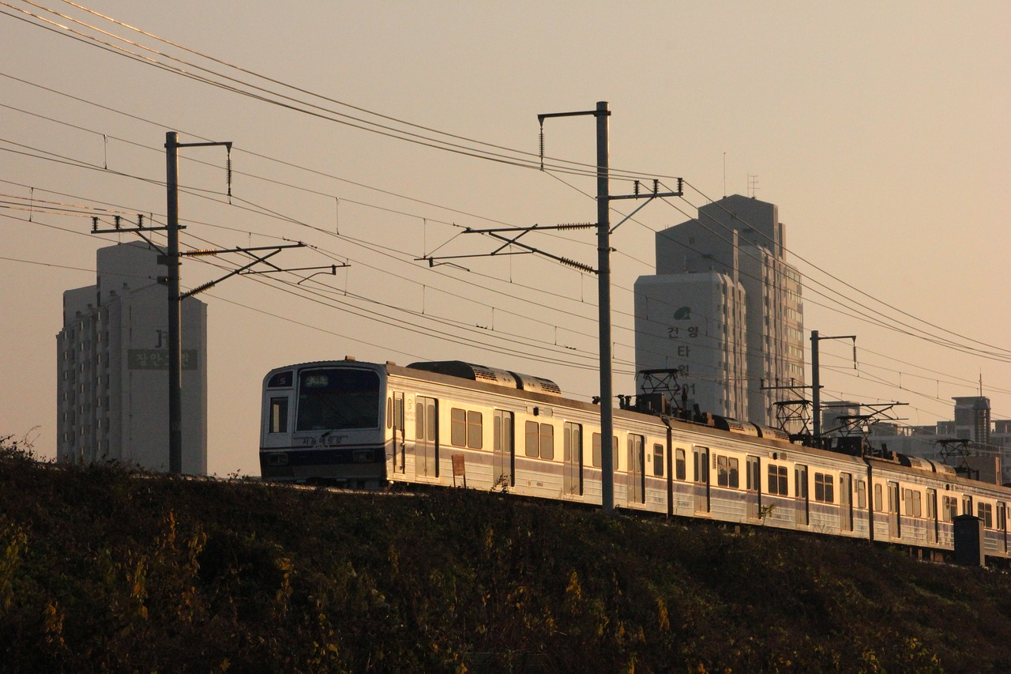

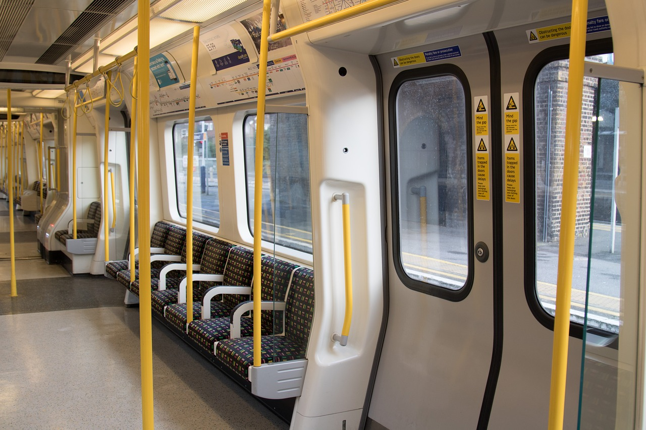
Focus your
business
Advertisements
Consultation
Where is the most crowd and based on
What you can put your advertisements
Where is the most place that people visit?
And how can you aim gathering
By use this data you can discover how can improve the MTA service

Slide 5

Data beats emotions
Sean Rad, Adly and Tinder founder

Slide 6

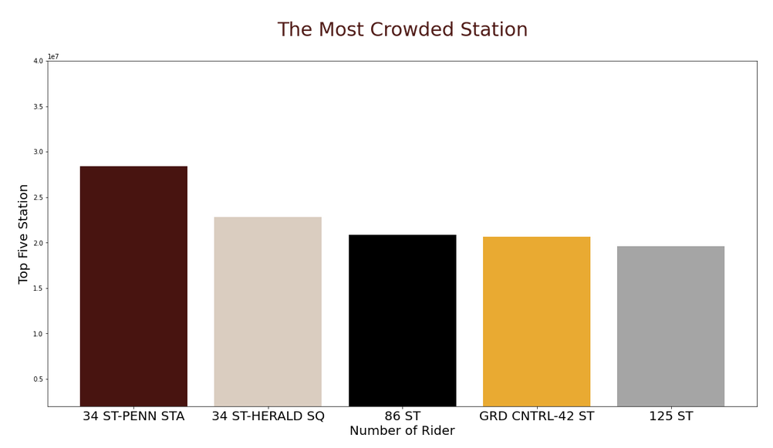

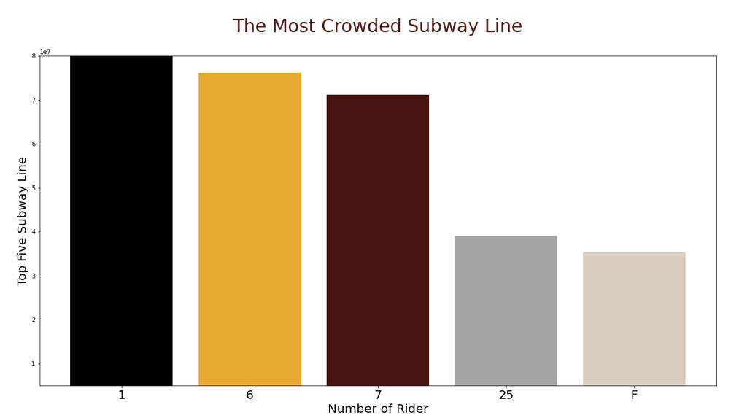

Slide 7
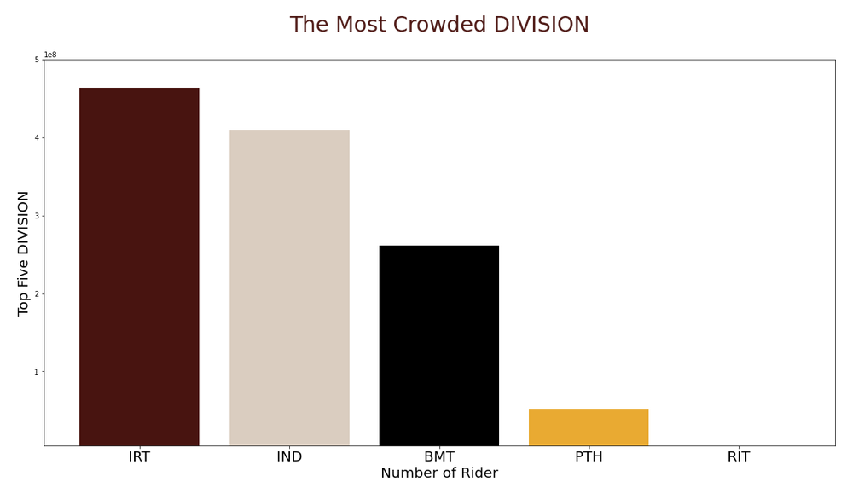
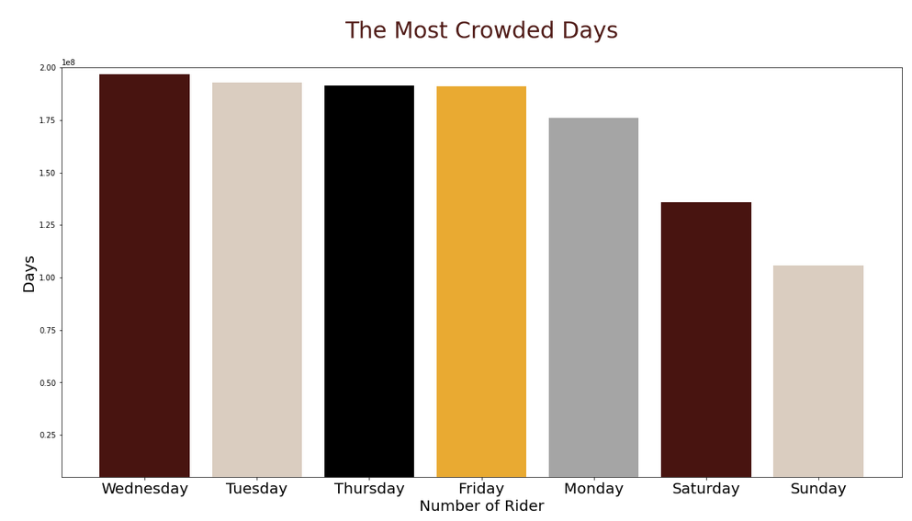

Slide 8
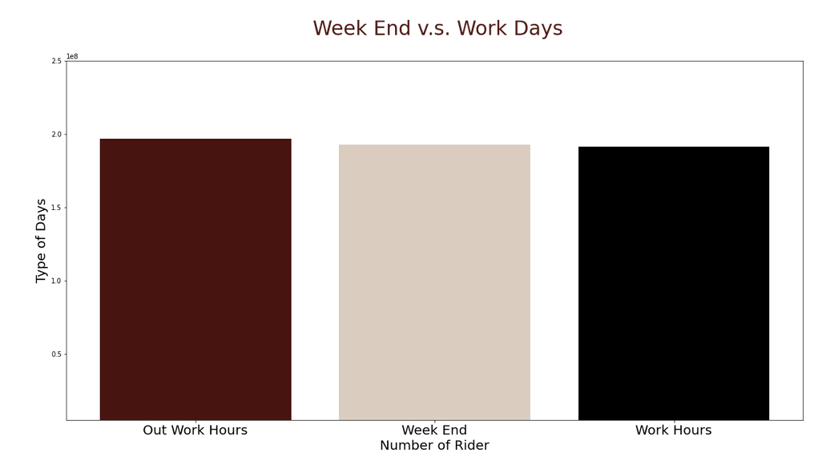
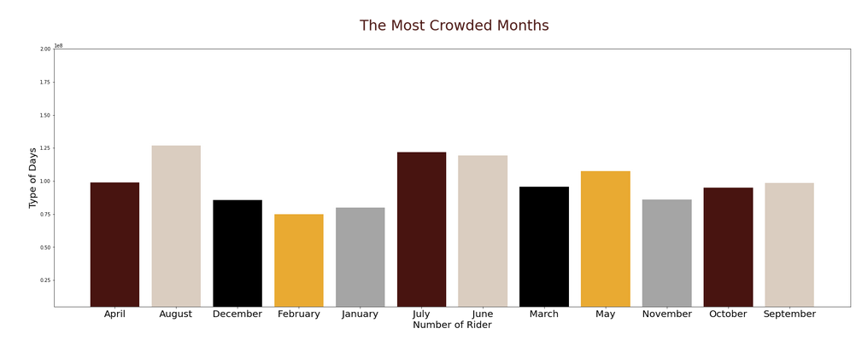

Slide 9



Central Park
Times Square
Statue of Liberty

Slide 10
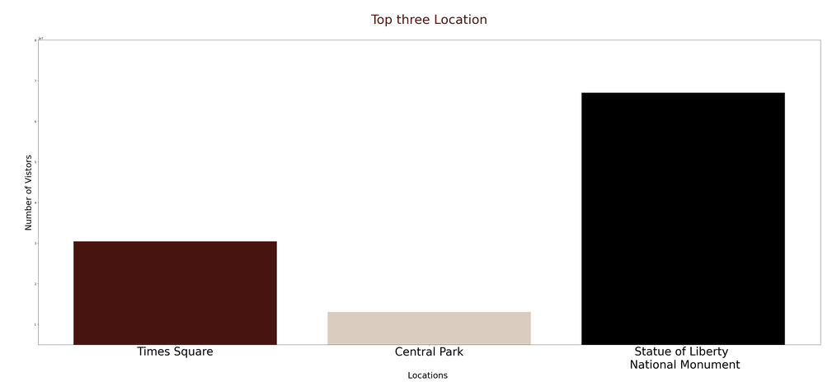
Central Park
Times Square
Statue of Liberty

Slide 11

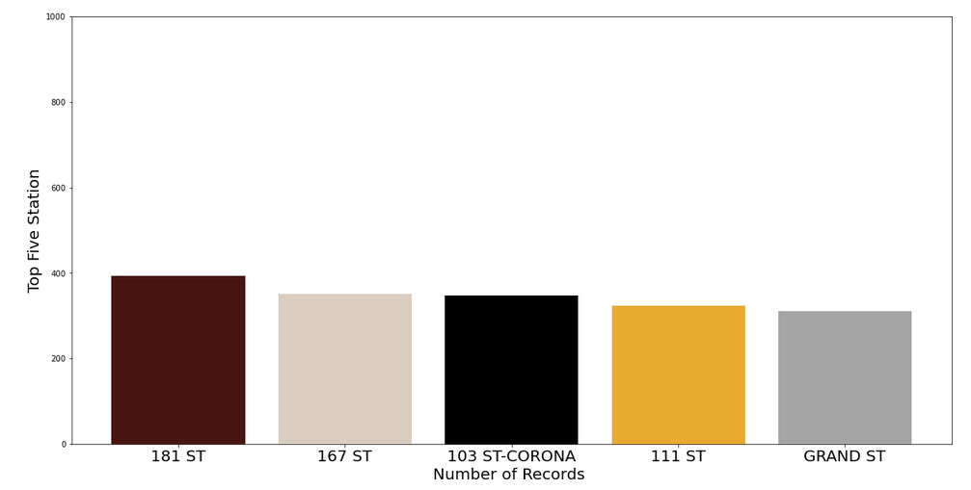
Increase The Capacity

Slide 12

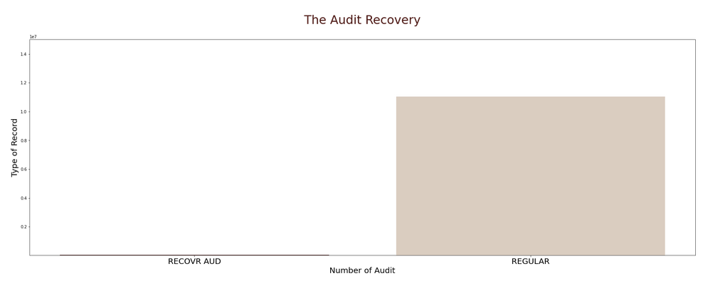
Fix this
Station

Slide 13
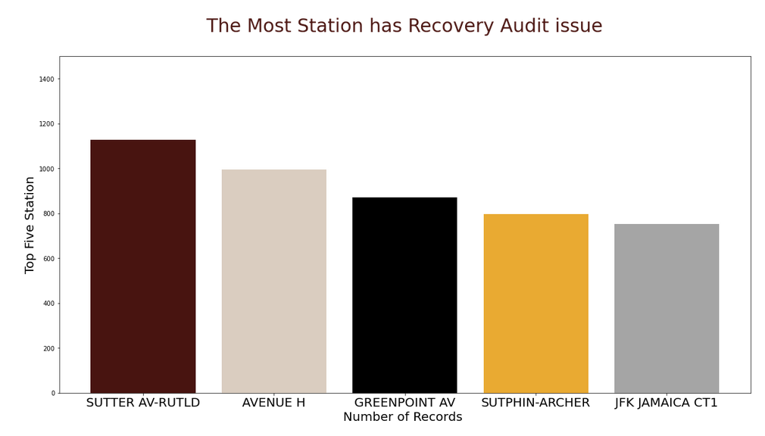
Fix this
Station

Slide 14




Tools to analyses the data
01
02
03
04
MS Excel
Jupyter
Python
SQLite

Slide 15
Step to Clean The Data
Duplication
Null Value
Fix Column
Add Column
01
02
03
04
The most issue of the data that some of them have duplication because of the recover audit

Slide 16
Step to Clean The Data
Duplication
Null Value
Fix Column
Add Column
01
02
03
04
After calculate the different between the previous Entries and current entries some day have null value

Slide 17
Step to Clean The Data
Duplication
Null Value
Fix Column
Add Column
01
02
03
04
Change the column name like C/A to control area and remove the white space from EXITS column

Slide 18
Step to Clean The Data
Duplication
Null Value
Fix Column
Add Column
01
02
03
04
Add column to add more meaningful for the data

Slide 19

Count
Traffic
Month Name
To calculate the exact entries and exits by subtract the current with previous
Add the Exits count with count entries to see the total traffic and how much the crowd
Add month name rather than have only date as number
Additional
Features
Day Name
Week Num
Cal Time
Define the name of day to find what is the weekend and what is the workday
To define the week number by transferer the date to week number
Change the time as number to know exactly what is the time

Slide 20

Convert
to Second
Cal Time
12:24:14
12 * 3600 :24 *60 :14
44654

Slide 21

1
panda
To store the data and handling the information
2
requests
To check the url if it exist or not
3
matplotlib
To draw chart and visualize the information
4
datetime
To handle the date and extract the day name and week number and month name
Packages
5
numpy
To use where and handle the list

Slide 22

Recommendations
Standard
record
01
Don’t reset
the count
02
04
Don’t use
cumulative
Don’t use
reverse
03

Slide 23

“Thank you for listening.
M o L T a H e B

